Slide 1

































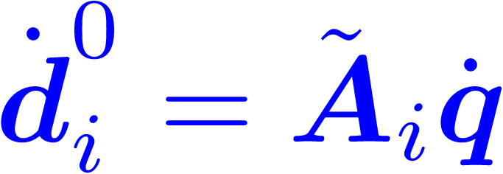
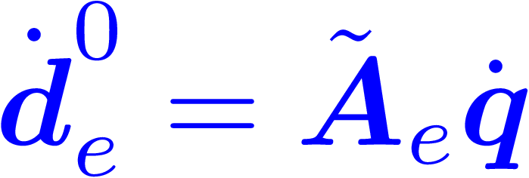















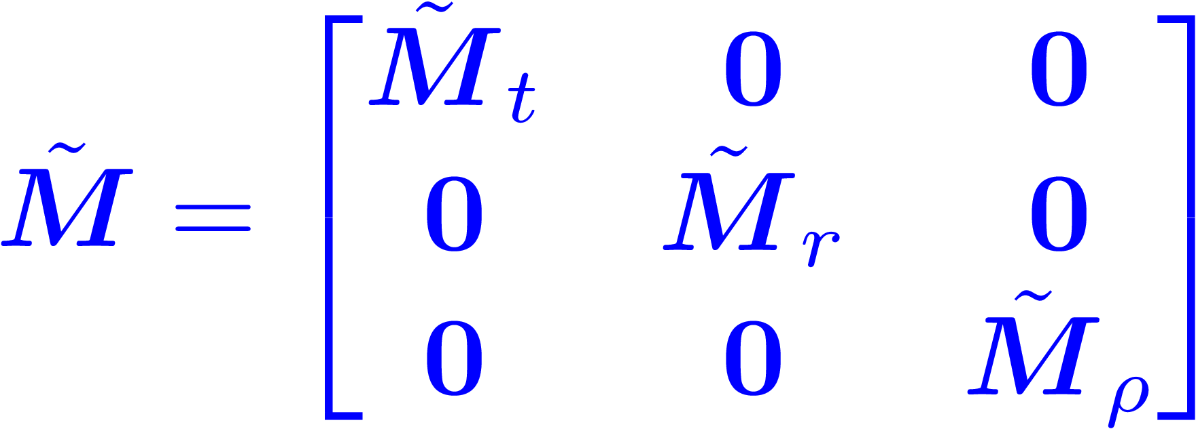

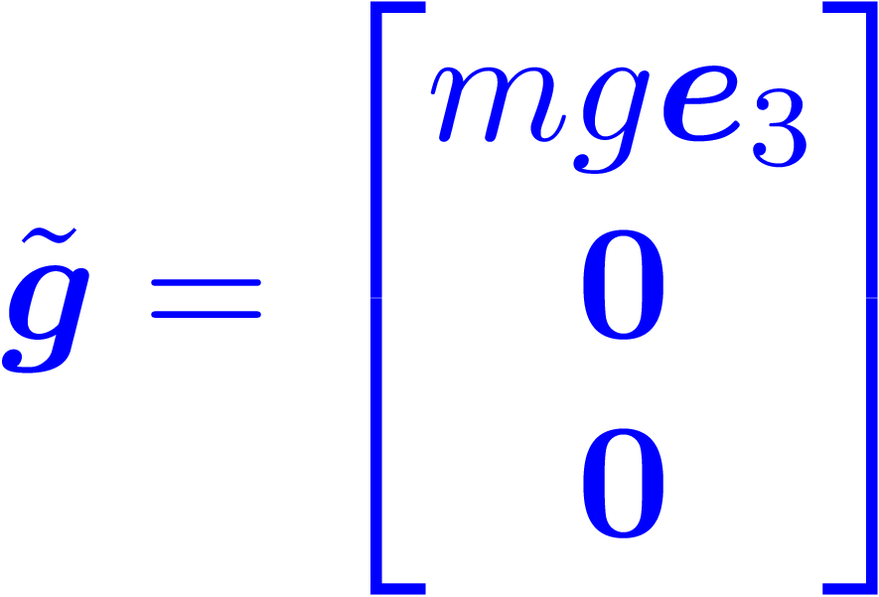
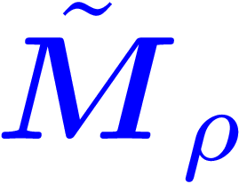
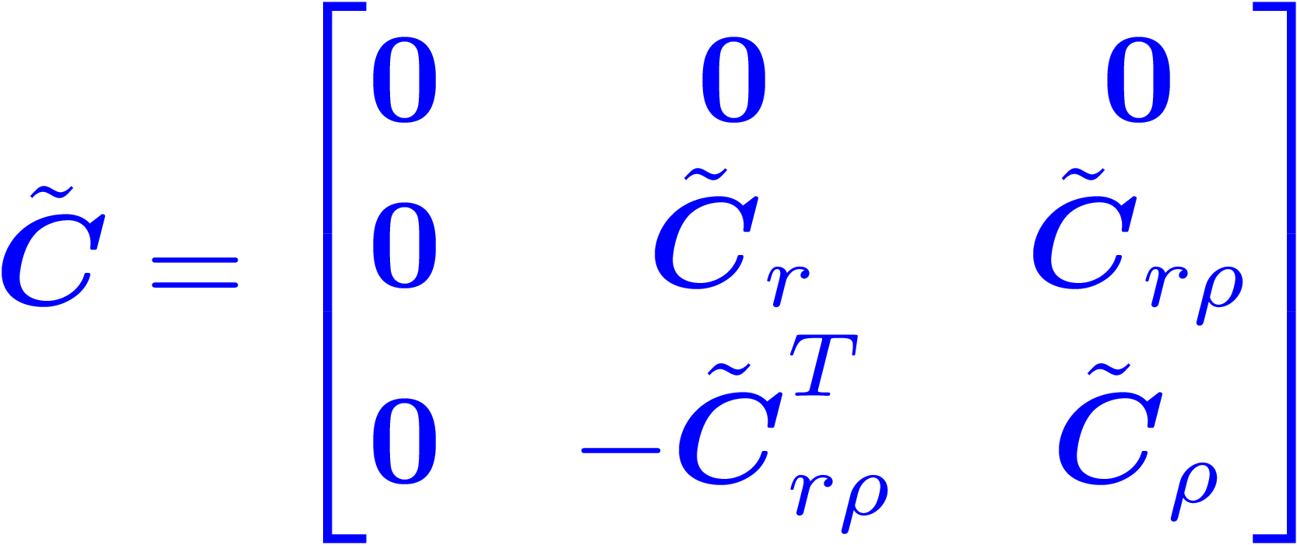
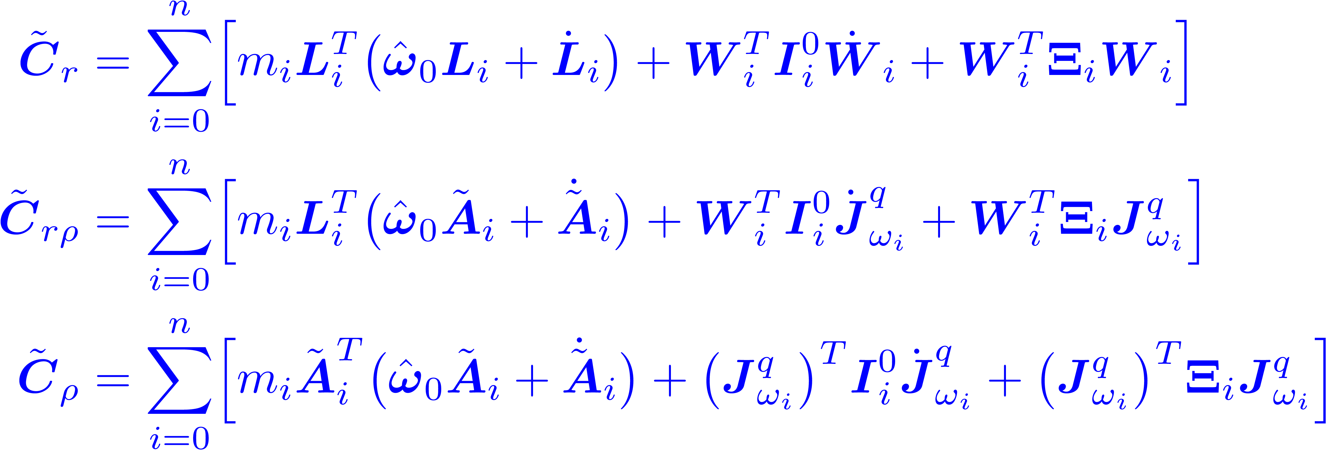





Computation Flowchart – Transformed Dynamics
System state
Inertia and geometry
Kinematics – Translation
Kinematics – Rotation
Transformed Dynamics – Preliminary
Transformed Dynamic – Whole-body
will be computed first.
Transformed Dynamic – End-effector

Slide 2









Computation Flowchart – Original Dynamics
Jacobians
Dynamic Matrices

Slide 3






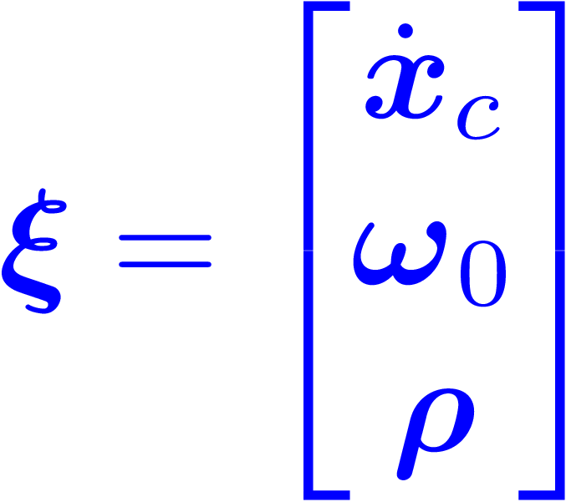










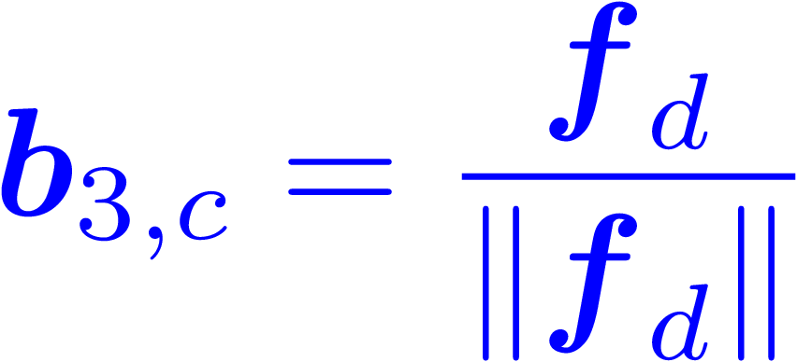



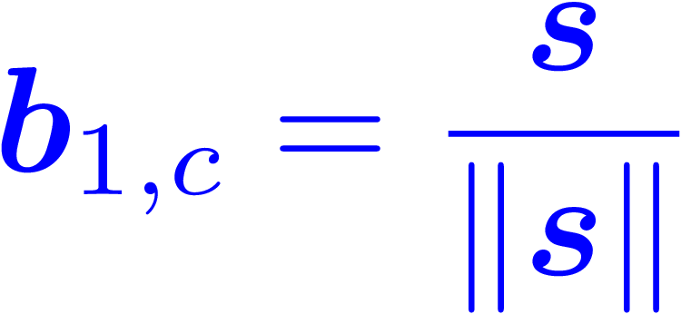


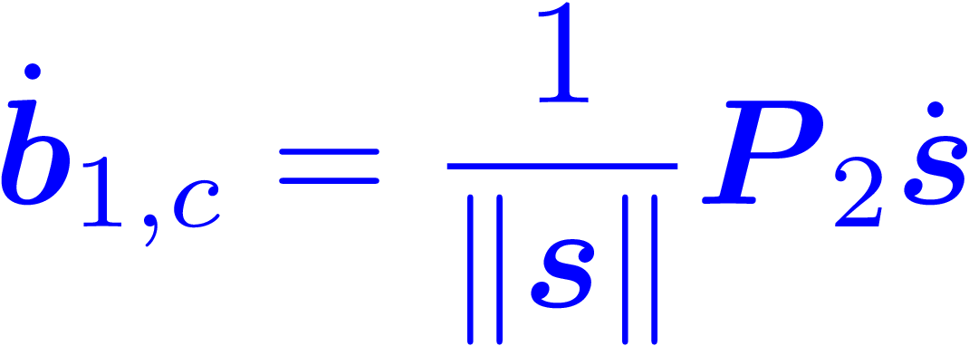











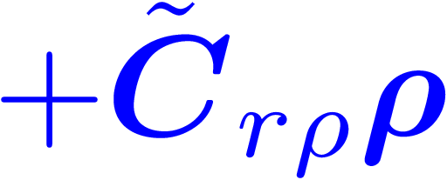










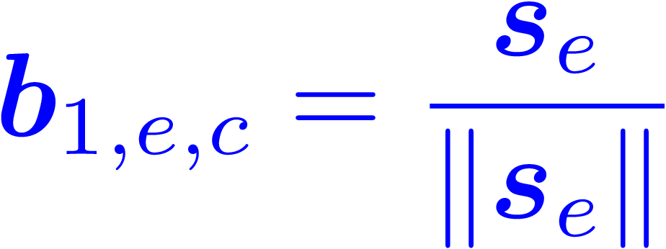










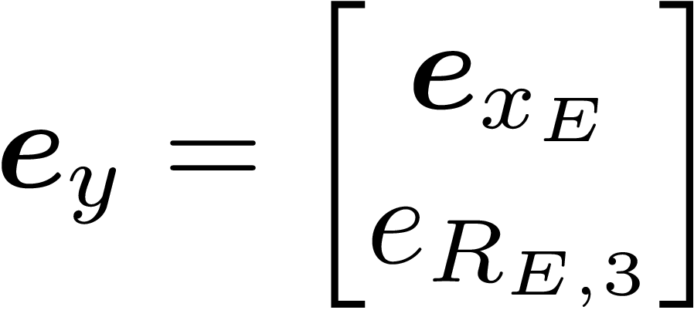


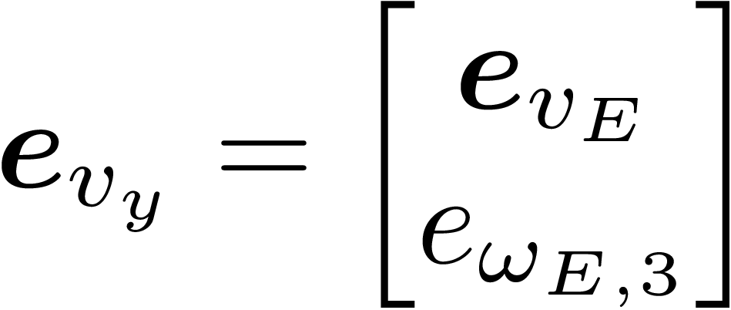
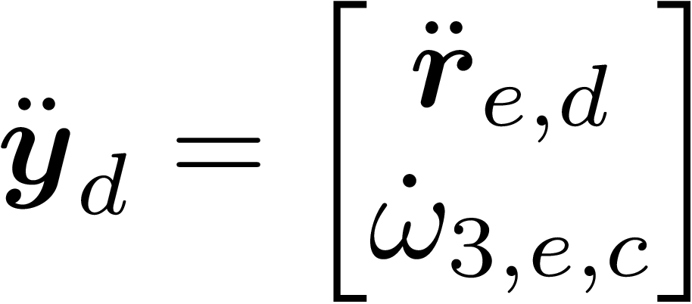

Computation Flowchart – Controller
Reference Trajectory
Control – Transformed State
Control – Translation
Control – Rotation
Control – Arm
Notes:
We need to change 4-th joint axis configuration to avoid the structural singularity of J_3y (last 4 columns)
For each joint, we have to incorporate the moment of inertia for each motor, especially for the last motor. Since the 4-th joint rotate around the z axis, the moment of inertia for a slender rod along itself is quite small. This leads to a small effective moment of inertia for 4-th joint in matrix \tilde{M}_{\rho}, which are 66x magnitude different from the other three joints. However, in real world, the link should also see motor’s inertia applying to the rotational axis. Otherwise, the system will be purely torque-driven links, which is numerically unstable.

